Slide 1
JS, Scroll- & FlatList
ListView kaldes nu en FlatList

Slide 2
Remarks fra sidst
Når I starter nyt projekt
Husk at bruge create-react-native-app fra installationsvejledningen
Lave øvelser forud?

Slide 3
Agenda for i dag
Lidt om JavaScript
Reusable components
ScrollView & FlatList

Slide 4
JavaScript

Slide 5
strings
Feature | Example
Strings in JavaScript are sequences of Unicode characters
The length of a string is indicated by its length property | 'hello'.length; // 5
String contains functions to manipulate itself and access its information | 'hello'.charAt(0); // "h" 'hello, world'.replace('hello', 'goodbye'); // "goodbye, world" 'hello'.toUpperCase(); // "HELLO"

Slide 6
Feature | Example
JavaScript distinguishes between null and undefined
JavaScript has a boolean type, with possible values true and false | false, 0, empty strings (""), NaN, null, and undefined all become false. All other values become true. Boolean(''); // false Boolean(234); // true
Boolean operations such as && (logical and), || (logical or), and ! (logical not) are supported
Comparisons in JavaScript can be made using <, >, <=, >=, ==, ===, !=, and !== | 123 == '123'; // true 1 == true; // true 123 === '123'; // false 1 === true; // false
JavaScript also contains two other prominent for loops: for...of and for...in | for (let value of array) { //do something with value } for (let property in object) { // do something with object property }

Slide 7
variabler
Feature | Example
let allows to declare block-level variables | // myLetVariable is *not* visible out here for (let myLetVariable = 0; myLetVariable < 5; myLetVariable++) { // myLetVariable is only visible in here } // myLetVariable is *not* visible out here
const allows to declare variables whose values are never intended to change | const Pi = 3.14; // variable Pi is set Pi = 1; // will throw an error because you cannot change a constant variable.
var is the most common declarative keyword | // myVarVariable *is* visible out here for (var myVarVariable = 0; myVarVariable < 5; myVarVariable++) { // myVarVariable is visible to the whole function } // myVarVariable *is* visible out here

Slide 8
JSON
Feature | Example
JavaScript objects can be thought of as simple collections of name-value pairs | var obj = new Object(); var obj = {};
This syntax: {} is also the core of JSON format and should be preferred at all times | var obj = { firstName: Hans’, lastName: ’Hansen’ details: { color: 'orange’, size: 12 } }; obj.details.color; // orange obj['details']['size']; // 12 obj.name = 'Simon’; obj['name'] = 'Simon';

Slide 9
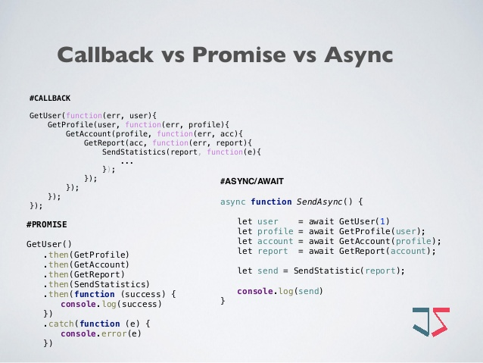

Slide 10



JS & RN resources
› Learn JavaScript at https://www.freecodecamp.org/
› React Native documentation at https://facebook.github.io/react-native/docs/getting- started.html
› More resources for JavaScript at https://developer.mozilla.org/en-US/

Slide 11
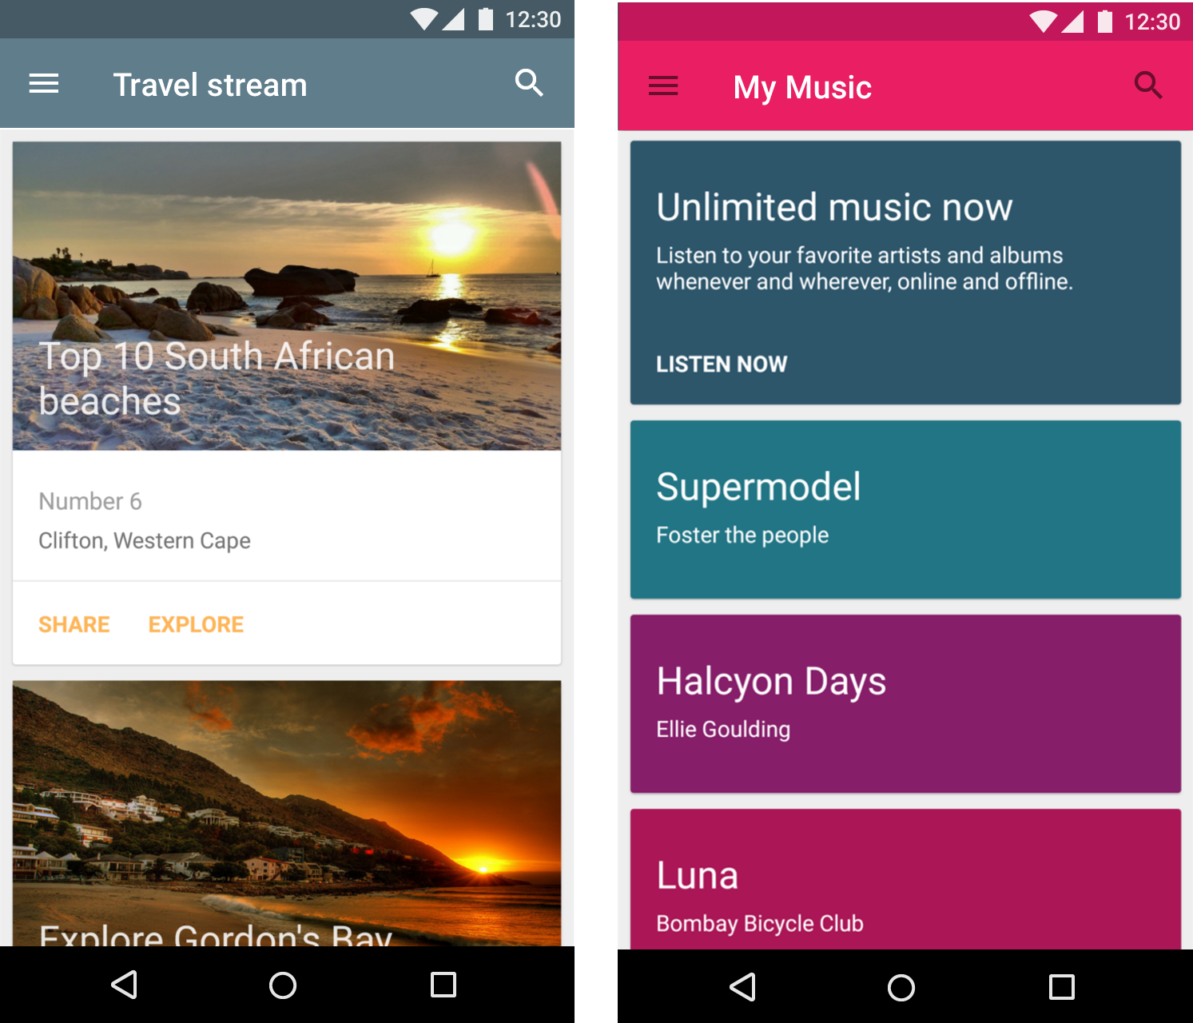
reusable components

Slide 12
Component lifecycle functions
De vigtige:
constructor() ➔
componentWillMount() ➔
render() ➔
componentDidMount() ➔
[runtime-loop] ➔
componentWillUnmount()
Se runtime-loop functions her

Slide 13
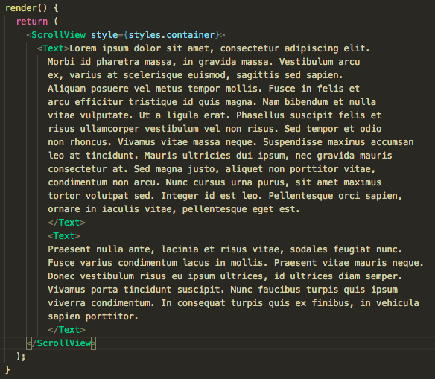
ScrollView

Slide 14
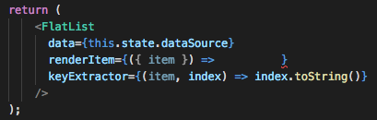
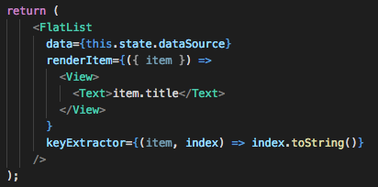
FlatList (ListView)

Slide 15
API
Den data vi skal arbejde med:
Taylor Swifts’ albums

Slide 16
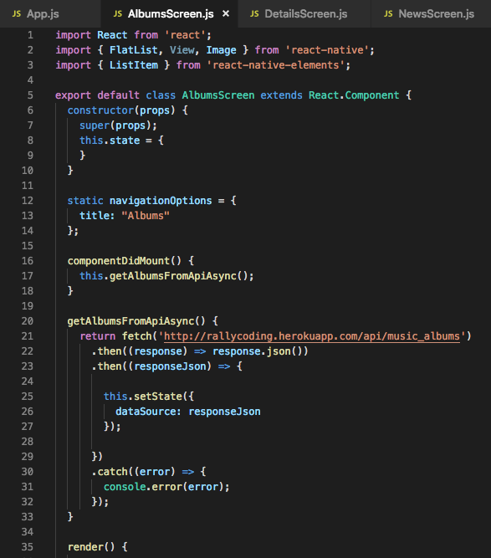
fetch data (ajax-kald)

Slide 17
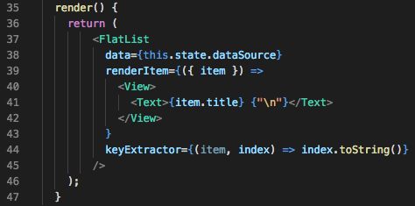
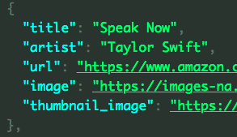
FlatList (igen)

Slide 18
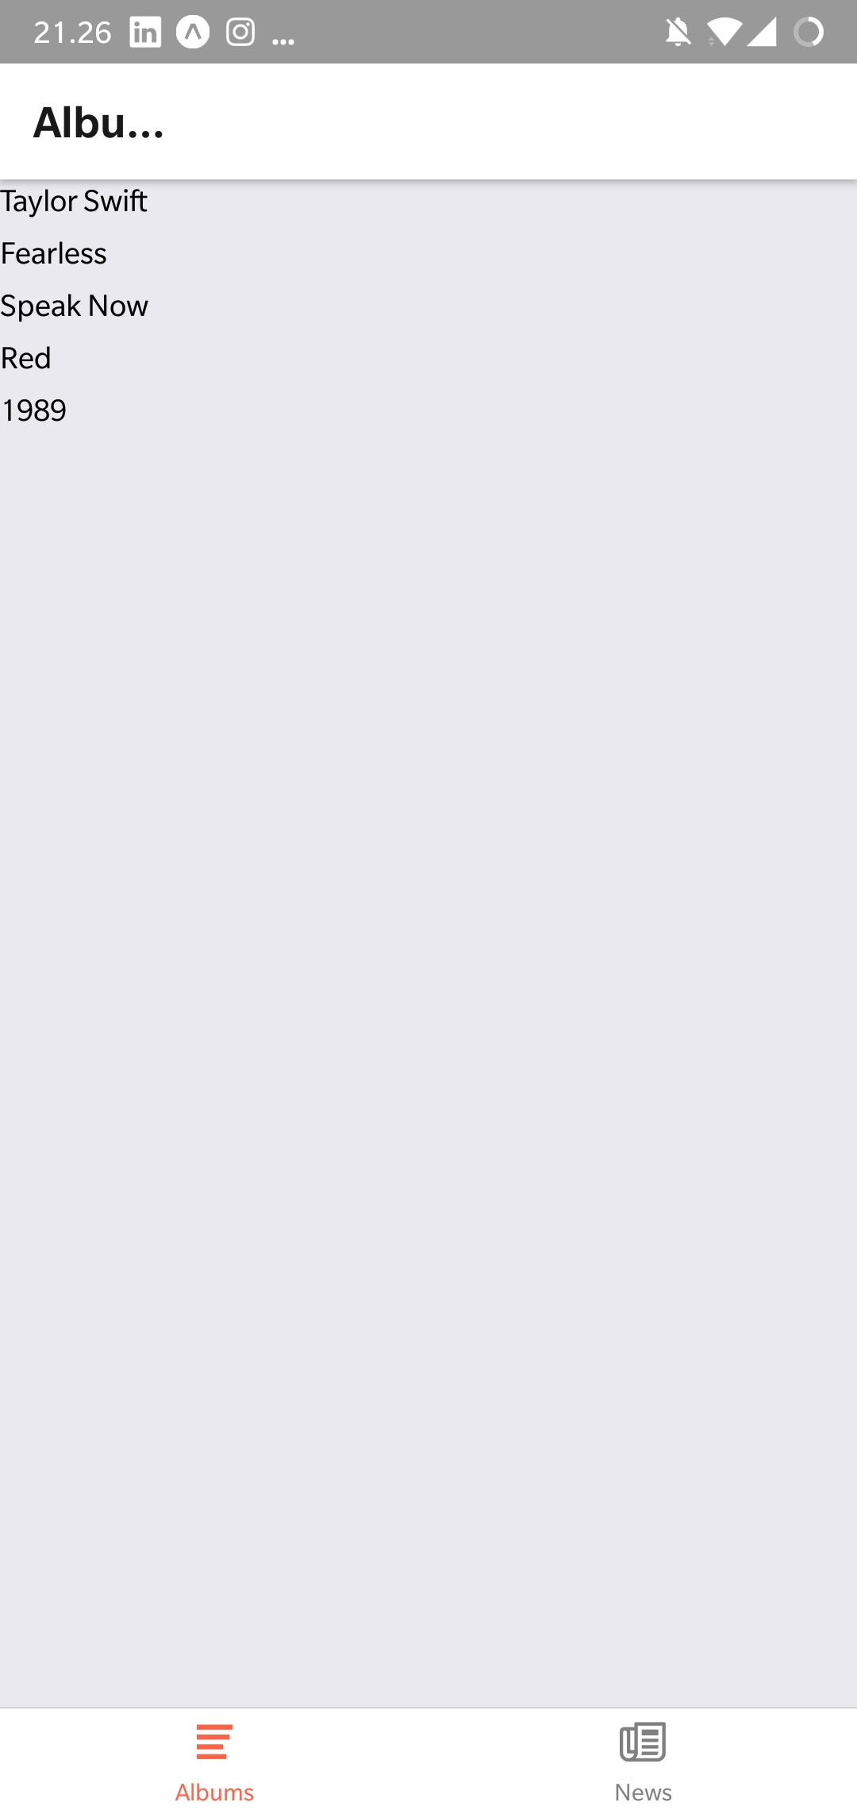
FlatList

Slide 19
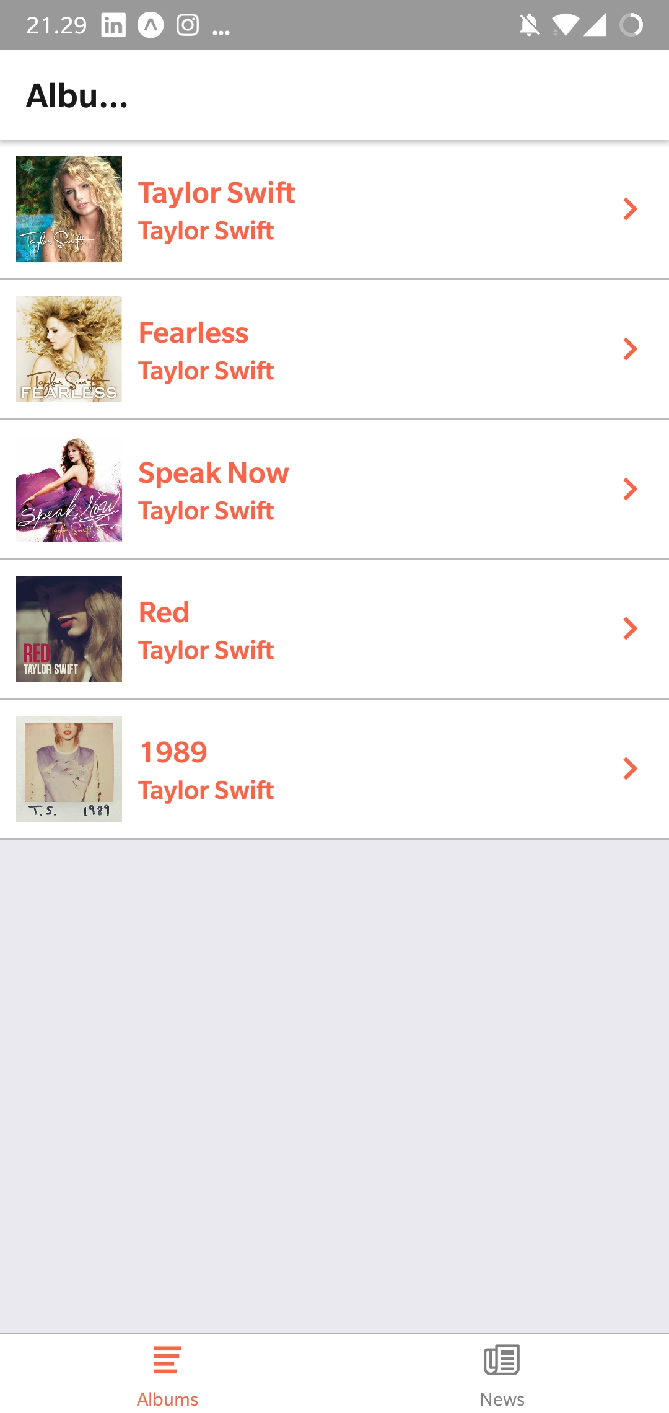
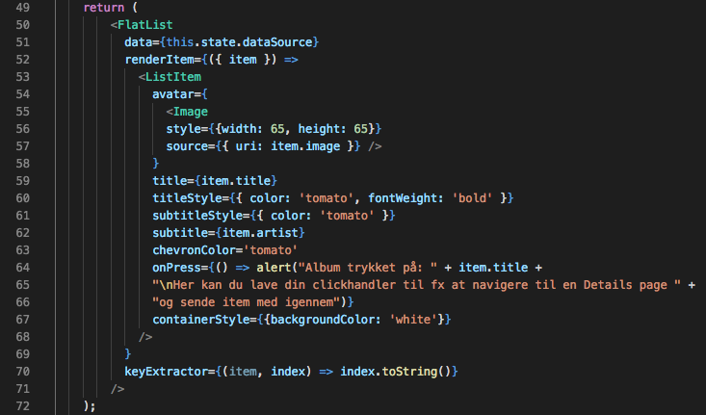
FlatList

Slide 20
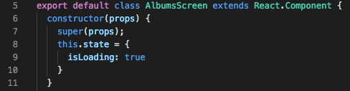
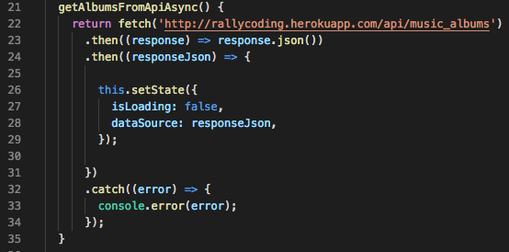
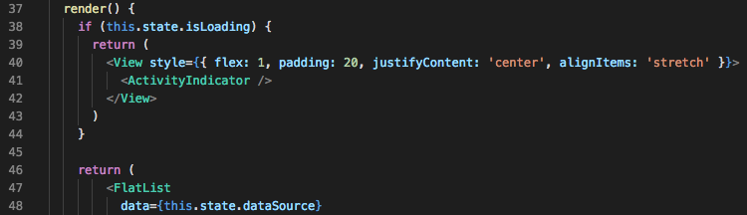
ActivityIndicator
lille bonus
_____________________________________________
1
3
2
4

Slide 21
øvelser

